Slide 1

The Iterated Prisoner's Dilemma and The Evolution of Cooperation EE495 Game Theory and Networked System
Jiaqi Guo JGR9647
Qiulin Li QLA2891
Notes:
This is report for Northwestern university, Social media mining, we are group 4

Slide 2



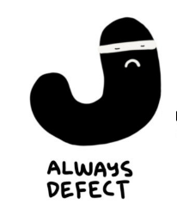
Contents
Iterated Prisoner's Dilemma
Axelrod’s Tournament
Strategy analysis (TIT FOR TAT, GRAFUAL …)
The Evolution of Cooperation (2 Special Situations)
Picture referenced from: https://medium.com/thinking-is-hard/a-prisoners-dilemma-cheat-sheet-4d85fe289d87

Slide 3
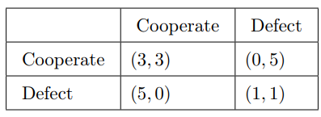


The Prisoner's Dilemma
Prisoner’s dilemma is a strange but fascinating thought experiment / game that can teach us all why some strategies for cooperation are better than others.
Obviously, for such a single-round prisoner’s dilemma game, the Nash equilibrium
Reference: https://en.wikipedia.org/wiki/Prisoner%27s_dilemma
Notes:
The prisoner's dilemma is a hypothetical game set up showing a situation where people won't want to work together even when it's beneficial to do so. It's just a long way of saying people don't like to be taken advantage of
Imagine two people being questioned about the same crime. They’re each talking to the interrogator separately, and the interrogator gives each person the same deal: they can choose to vouch for the other person’s innocence or guilt.
The reason this is tricky is that if you know what the other person is going to do, it’s always to your advantage to say the other person is guilty. BUT since you don’t know what the other person will do, your average reduction will be greater if you cooperate

Slide 4




The Iterated Prisoner's Dilemma
In one-off games, defecting gives a higher payoff, does not matter what other is doing
With multiple games, if the opponent cooperates and defect at random, or follows a set of pattern, always defecting still gives the best payout.
Always defect
22
Start off cooperate then defect
17
Random cooperate and defect
Always cooperate
12
Picture referenced from: https://www.youtube.com/watch?v=BOvAbjfJ0x0
Notes:
The iterated prisoner's dilemma is just like the regular game except you play it multiple times with an opponent and accumulate the scores. In this game, all players have the same goal, which is also to maximize the utility (corresponding to minimizing years in prison) over a repetition of the game. Similar to one off prisoner dilemma game, in multiple games, if the opponent cooperates and defect at random, or follows a set of pattern, always defecting still gives the best payout. That is because, here, like in a one-off game, defecting has no consequences. This situation will change if the player make decision depending on what the other player did,

Slide 5
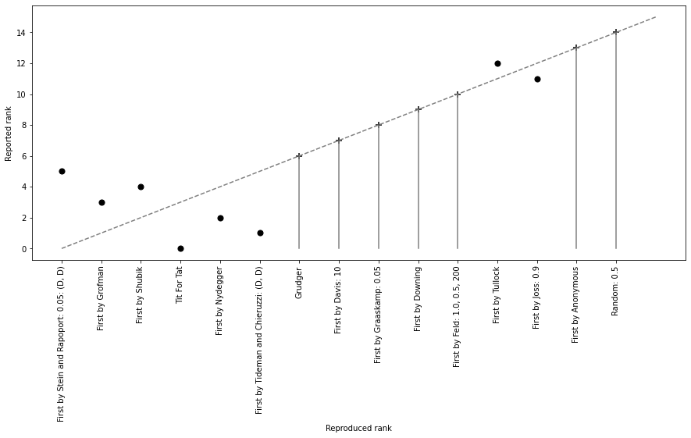
Axelrod’s Tournament
14 strategy submitted + the 50/50 random strategy
Each strategy was paired with each other strategy for 200 iterations of a Prisoner's Dilemma game
Scored on the total points accumulated through the tournament.
Reference: https://doi.org/10.1177/002200278002400101
Notes:
In the 1980s, professor of Robert Axelrod ran a tournament inviting strategies from collaborators all over the world for the Iterated Prisoner’s Dilemma. The winner was a strategy called TIT for TAT, and the figure at the left illustrate the rank of the total points. We have reproduced this tournament and get similar result. The difference of the first 6 strategies may caused by the insufficient repetitions of Axelrod’s works.
In today’s presentation, we will start from the winner of this tournament，TIT for TAT. Because many recent strategies are the variant of it.

Slide 6

TIT FOR TAT
Cooperates on the first round and then just copies what the other person did last round
Since it can reciprocate quickly against defectors. Any strategy against it would get instantly punishment and put into a bad situation (get lower payoff)
TIT FOR TAT
3 | 0 | 1 | 5 | 3 | 12
CO | CO | DE | DE | CO
CO | DE | DE | CO | CO
3 | 5 | 1 | 0 | 3 | 12
Retaliating: it punishes defection, which prevent some losses and disincentive an opponent from defecting
The only way to maximize payoff is start off cooperating and never defect
Notes:
TIT for TAT is a simple strategy, but one thing is, it reciprocate quickly against defectors. Any strategy against it would get instantly punishment and put into a bad situation. For example, if the opponent defects at the second rounds which is shown in the figure here, it will get some instant punishment. The payoff will drop to 1 and 0. Even if it tries to go back to cooperating, it will gain less than keeping cooperate with TIT for TAT for whole rounds. So, TIT for TAT is a kind of retaliating strategy that punishes defecting and disincentive an opponent from defecting. Here, we want to compared it with other strategies which called GRADUAL

Slide 7

Problem of TIT FOR TAT
Because of the copying nature of TIT FOR TAT, it can not ever beat an opponent.
TIT FOR TAT
3 | 0 | 1 | 5 | 3 | 12
CO | CO | DE | DE | CO
CO | DE | DE | CO | CO
3 | 5 | 1 | 0 | 3 | 12
TIT FOR TAT
3 | 3 | 3 | 3 | 0 | 12
CO | CO | CO | CO | CO
CO | CO | CO | CO | DE
3 | 3 | 3 | 3 | 5 | 17
Always defect can only win or tie, but the payoff is lower(bad)
Notes:
One major feature of TIT for TAT is, Because of the copying nature of TIT FOR TAT, it can not ever beat an opponent. It can either tie or lose, depends on which round its opponent defects. The opposite is always defect, it can only tie or win if the opponent want to cooperate.

Slide 8
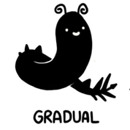
GRADUAL
Never the first to defect, but once the other defected it never cooperate again
Compared with GRADUAL, TIT FOR TAT allows cooperation if the person wants to cooperate again
3 | 0 | 1 | 5 | 5 | 14
CO | CO | DE | DE | DE
CO | DE | DE | CO | CO
3 | 5 | 1 | 0 | 0 | 9
GRADUAL
The punishment GRUDGER gives, hurts the punisher alongside the punish.
Notes:
Gradual is never the first to defect, but once the other defected, it never cooperate again, Compared with GRADUAL, TIT FOR TAT allows cooperation if the person wants to cooperate again, so that both TIT for TAT and his opponent can cooperate forwards. So, this is why tit for tat wins this tournament, it is retaliating, it is disincentives being taken advantage of, and it is forgiving.

Slide 9

TIT for TWO TATS
Require two defections before it retaliate
When play with strategy like Joss, echo effect may occur.
It prevents the echo effects that hurt regular TIT for TATs.
TIT FOR TWO TATs
3 | 0 | 3 | 3 | 3 | 14
CO | CO | CO | CO | CO
CO | DE | CO | CO | CO
3 | 5 | 3 | 3 | 3 | 9
Tester: starts out cooperating but tries defecting to say how opponent react. If the opponent punishes, it cooperates to apologize, and never defect again.
3 | 0 | 3 | 0 | 3 | 9
CO | CO | CO | CO | CO
CO | DE | CO | DE | CO
3 | 5 | 3 | 5 | 3 | 19
TIT FOR TWO TATs
Over Forgiving
TESTER
Notes:
TIT for two TATs increase the rounds of defection before it retaliate. Which can prevent the echo effects that hurt regular TIT for TATs. But when facing with strategies like tester who starts out cooperating at first but tries defecting to see how the opponent react. TIT for two TATs may become too forgiving.
So far, we see, most strategies trying to improve the tit for tat strategy, by let it to be less nice and trying to find a way to capitalize on defection, some stratege instead avoid punishing every defection, and ended up being better in the long run.

Slide 10
The Evolution of Cooperation

Slide 11
Moran Process (Evolution of Cooperation)
The Moran process is a common population model of natural selection, which works as follows. Given an initial population of players, the population is iterated in rounds consisting of:
1. matches played between each pair of players, with the cumulative total scores recorded
2. a player is chosen to reproduce proportional to the player’s score in the round
3. a player is chosen at random to be replaced
TIT FOR TAT
Always
Defector
Always
Defector
Cooperator
TIT FOR TAT
TIT FOR TAT
Cooperator
Random
Always
Defector
Cooperator
Reference:
[1] https://en.wikipedia.org/wiki/Moran_process
[2] Moran, P. (1958). Random processes in genetics. Mathematical Proceedings of the Cambridge Philosophical Society, 54(1), 60-71. doi:10.1017/S0305004100033193
Notes:
Let’s say we are in a reproduction situation. These payoff of each strategies in the tournament represent resources that could be used for reproduction. For strategies with high payoff like TIT for TAT, it will reproduce more of them into the next generation. For strategies with lower pay off like Random, we will put fewer of them into the next generation. Let’s consider a population of 9 players, which consist 3 TIT for TATs, 3 Always Defectors, 3 Cooperators and 1 random

Slide 12
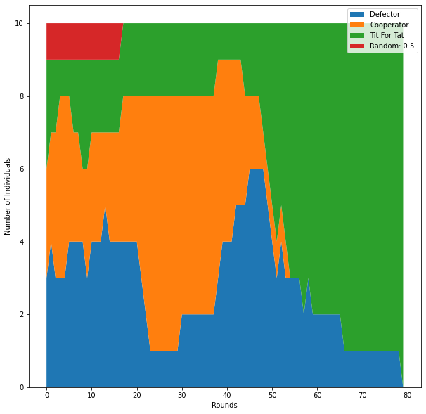
Example 1: A MIX POPULATION
TIT FOR TAT
Always
Defector
Cooperator
TIT FOR TAT
TIT FOR TAT
Always
Defector
Cooperator
Always
Defector
Random
Cooperator
1. When all 4 types of individuals exist:
Payoff: Defector > TIT For TAT > Random > Cooperator
2. When Random are eliminated at round 20
Payoff: Defector > TIT For TAT > Cooperator
3. When Cooperators are eliminated at round 55
Payoff: TIT For TAT > Defector
4. Only TIT For TAT survive.
Notes:
Through the simulation of Moran process, we can see the change process of four populations from the figure on the right. The Defector, did well at the start, but as its victim, Cooperator went extinct, its population declined as well. The real successful strategies were ones that could work well with other successful strategies, basically, they are those nice or otherwise cooperative strategies. They support one another and were able to continue to reproduce.

Slide 13
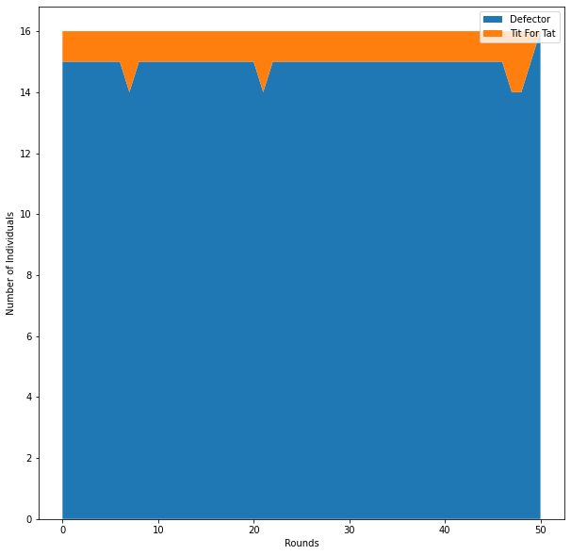
Example 2: DEFECTOR WORLD I
TIT FOR TAT
Always
Defector
Always
Defector
Always
Defector
Always
Defector
Always
Defector
Always
Defector
Always
Defector
Always
Defector
Always
Defector
Always
Defector
Always
Defector
Always
Defector
Always
Defector
Always
Defector
Always
Defector
Always
Defector
Can single TIT For TAT invade a group of always defectors?
The result is No, because TIT FOR TAT will have nobody to cooperate with and just comes away as the worst reproducer
TIT FOR TAT
0 | 1 | 1 | 1 | 1 | 4
CO | DE | DE | DE | DE
DE | DE | DE | DE | DE
5 | 1 | 1 | 1 | 1 | 9
Always
Defector
Notes:
Let’s consider another situation, it is a world of always defectors, it is a cruel world with otherwise the rules. Can a nice mutation establish itself? Can something like TIT For TAT invade a group of always defectors? Unfortunately, the result is No, because a single TIT For TAT can not find anybody in population to cooperate with, and always come away as the worst reproducer. However we can improve the situation by adding a extra TIT FOR TAT.

Slide 14
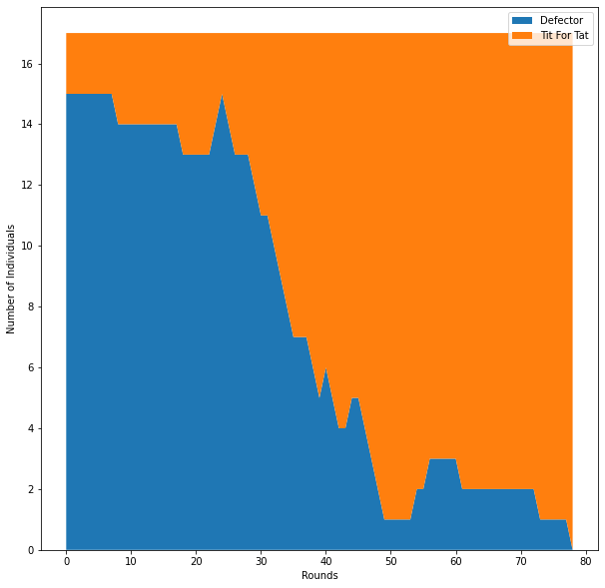
Example 2: DEFECTOR WORLD II
TIT FOR TAT
Always
Defector
Always
Defector
Always
Defector
Always
Defector
Always
Defector
Always
Defector
Always
Defector
TIT FOR TAT
Always
Defector
Always
Defector
Always
Defector
Always
Defector
Always
Defector
Always
Defector
Always
Defector
Always
Defector
If there are a couple TIT FOR TATs, then they could gain more from one another than they loss to the defector in the tournaments.
TIT FOR TAT
3 | 3 | 3 | 3 | 3 | 15
CO | CO | CO | CO | CO
CO | CO | CO | CO | CO
3 | 3 | 3 | 3 | 3 | 15
Always
Defector
1 | 1 | 1 | 1 | 1 | 5
DE | DE | DE | DE | DE
DE | DE | DE | DE | DE
1 | 1 | 1 | 1 | 1 | 5
>
TIT FOR TAT
Always
Defector
Notes:
If there are a couple TIT FOR TATs, then they could gain more from one another than they loss to the defector. So, everything become different. And eventually they would end up taking over and once established, it would be really hard for a non-nice strategy to invade TIT FOR TAT, because TIT FOR TAT has the properties of retaliating. Those non-nice strategy will get lower payoff when playing game with TIT FOR TAT, and become the worst reproducer.
TIT for TAT does quite well in these model reproduction situations, it can invade other strategies, and it is difficult to be invaded. But in a larger reproduction game, it has no foresight and almost no memory. Instead, it just reacts to specific situations

Slide 15
Thank you for your listening!
Referenced:
[1] Axelrod, Robert, and William D. Hamilton. "The evolution of cooperation." science 211.4489 (1981): 1390-1396.
[2] Moran, P. (1958). Random processes in genetics. Mathematical Proceedings of the Cambridge Philosophical Society, 54(1), 60-71. doi:10.1017/S0305004100033193

